Slide 1
Dryer performance
Group:809b

Slide 2
Key performance
The dyer KPI is calculated by
Actual dry quantity / Total run time
In order to optimize the planning schedule, the total dryer performance will be evaluated by KPI combined with three process time.

Slide 3
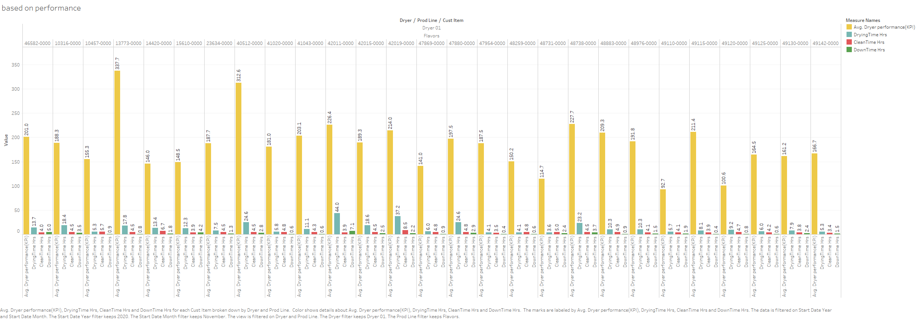
This sample is focused on November 2020, Flavors prodline.
The chart explains the detail performance of Dryer 01 on every November cust item. The kpi is evaluated on average value.
We can see, for example, cust item 13773-0000 has the highest performance with relatively less drying time. 42011-0000 however is on the opposite.
* Part of story2

Slide 4
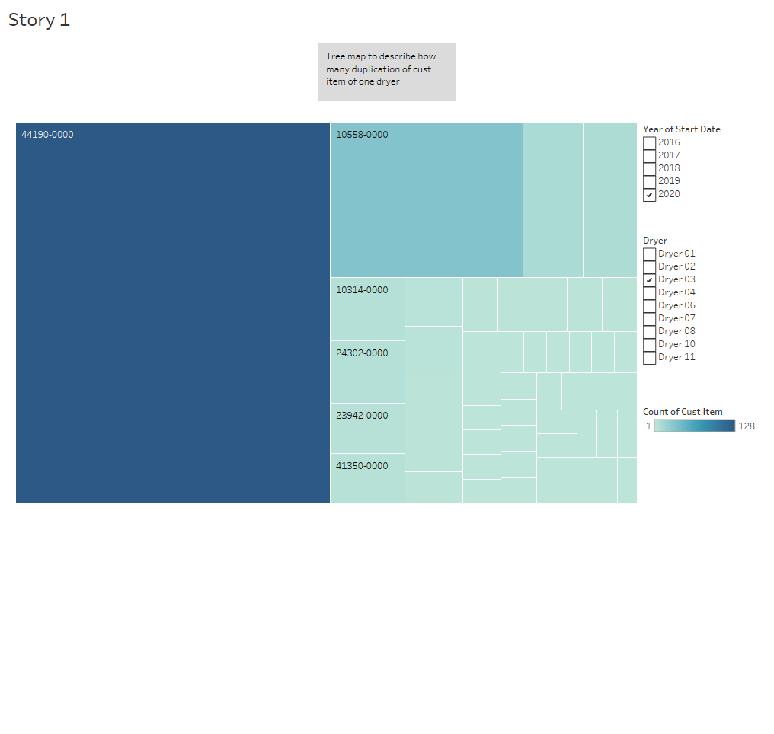
Tree map is used to find the most duplicated cust item, thus can be used to analyze each process time in story2.

Slide 5
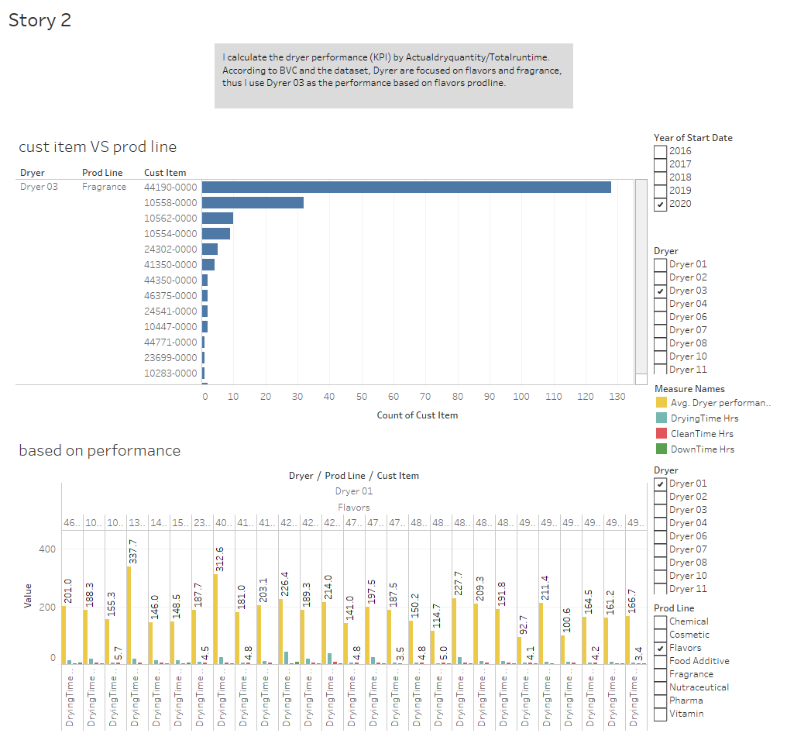
According to BVC and the dataset, Dyrer’s workflow are mainly focused on flavors and fragrance, Dyrer 03 is an example which has the most duplicated cust item on Nov 2020.

Slide 6
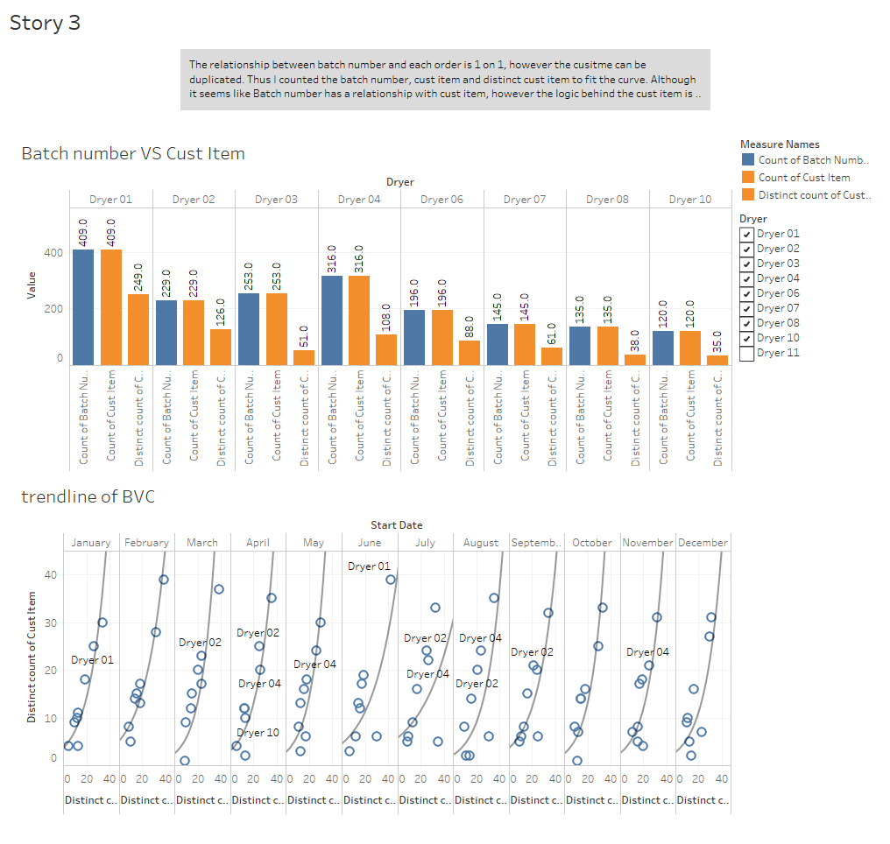
The batch number is unique for each order, thus I count the whole batch number and show the difference between batch number and the distinct cust item of that same time period. The curve is fitted based on exponential method.

Slide 7
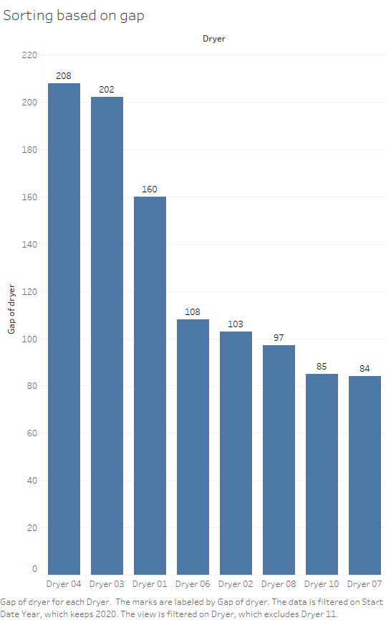
The meaning of gap is the difference between count of batch number and distinct count of cust item.
The relationship between batch number and each order is 1 on 1, however the cust item can be duplicated. Although it seems like Batch number has a relationship with cust item, however the logic behind the cust item is different from the batch number which is generated by computer. So that the trendline and this histogram is more suitable on sorting the dryer which processed with the most similar materials.

